Slide 1
MULTISTAGE DOWNLOAD

Slide 2
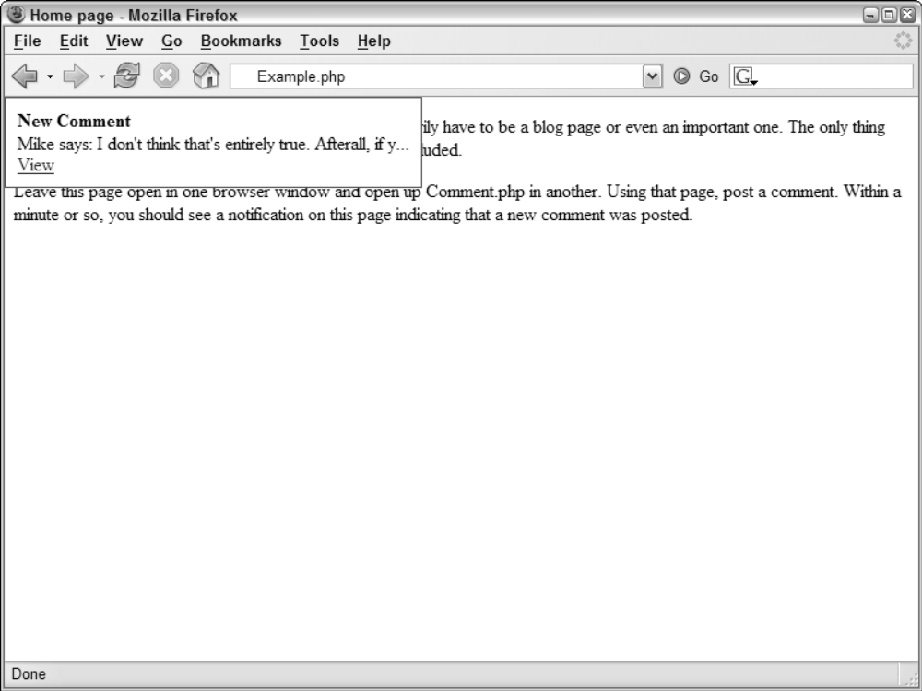
New Comment Notifier Example
It alerts the user when a new comment has been added

Slide 3
Multi-Stage Download
The problem : speed at which pages download
56 Kbps modems: web designers were much aware of how much their pages “weighed”
Residential broadband Internet solutions : many sites have upgraded, including multimedia, more pictures, and more content
Advantage of this approach: gives the user more information
Disadvantage of this approach: leads to slower download times
The solution: Multi Stage Download-Ajax Pattern

Slide 4
Multi-Stage Download
The most basic functionality is loaded into a page initially
The page then begins to download other components that should appear on the page
User leaves the page before all the components are downloaded: No consequence
User stays on the page for an extended period of time: Extra functionality is loaded in the background
Advantage: You, as the developer, get to decide what is downloaded and at what point in time

Slide 5
Multi-Stage Download
When you first visit the page, it is a very simple page with minimal content
A series of requests is being fired off to fill in more content on the page
Within a few seconds, the page jumps to life as content from several different locations is pulled in and displayed

Slide 6
Multi-Stage Download
Downside: The page must work in its simplest form for browsers that don’t support Ajax technologies
The basic functionality must work without any additional downloads
Solution : Graceful degradation
Graceful degradation: Those browsers that support Ajax technologies :extensive interface ,other browsers :simple, bare-bones interface
Important if you are expecting search engines to crawl your site

Slide 7
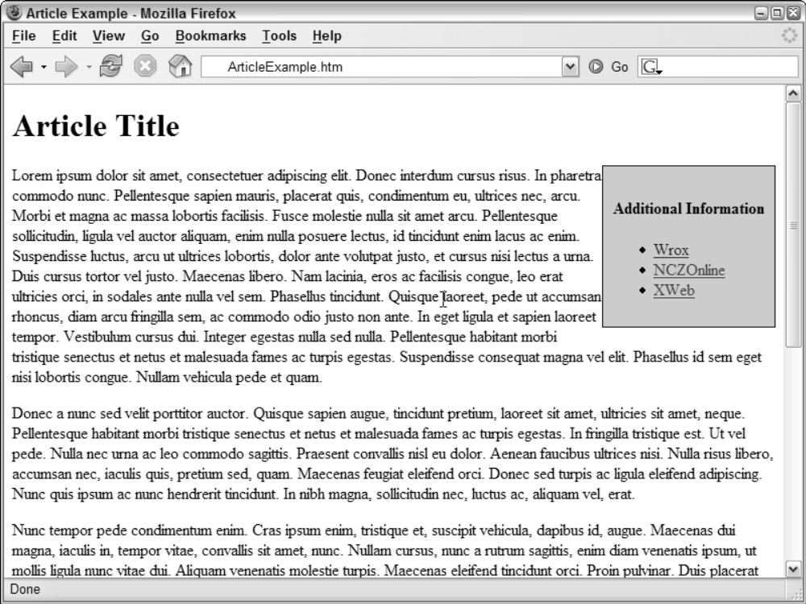
Additional Information Links Example
The article text is the main content on the page, so it should be downloaded when the page is initially loaded. The additional links aren’t as important, so they can be loaded later.

Slide 8


